Slide 1
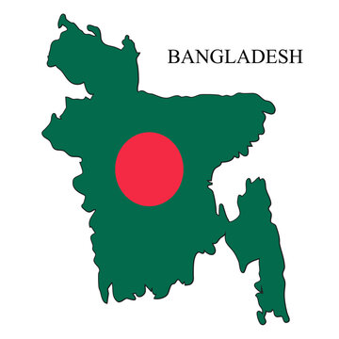
About Bangladesh
Submitted to
Dr. Rahat Hossain Faisal
Associate Professor
University of Barishal
Submitted by
Sujan Mallik
University of Barishal

Slide 2
Historical place of Bangladesh
Lalbagh Fort
Ahsan Manzil
Panam city
Mahasthangarh
Shat Gambuj Mosque
Liberation War museum
Mainamati
Star Mosque
Shaheed Minar
National Memorial
Sundarbans

Slide 3
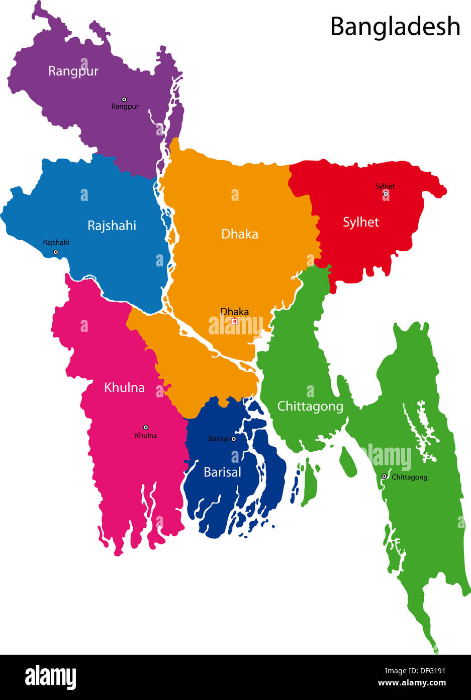
Geographical location of Bangladesh
Geography of Bangladesh Bangladesh has a geographical area of ​​147,570 square kilometers, which is slightly larger than Greece. Its geographical location is 20°34' N to 26°38' N latitude and 88°01' E to 92°41' E longitude. Its maximum extent from east to west is about 440 km and its maximum extent from north northwest to south southeast is 760 km. Bangladesh is bordered by India's West Bengal, Assam, Meghalaya, Tripura and Myanmar to the west, north, east and south-east respectively. Bangladesh has a total land border length of 2400 km, 92% of which is with India, 8% with Myanmar. The country borders the Bay of Bengal in the south. Although Bangladesh is a small country in terms of size, its coastline is more than 483 kilometers long. Bangladesh has a territorial sea limit of 12 nautical miles (22.22 km) and an economic sea limit of 200 nautical miles (370.40 km) from the coast

Slide 4
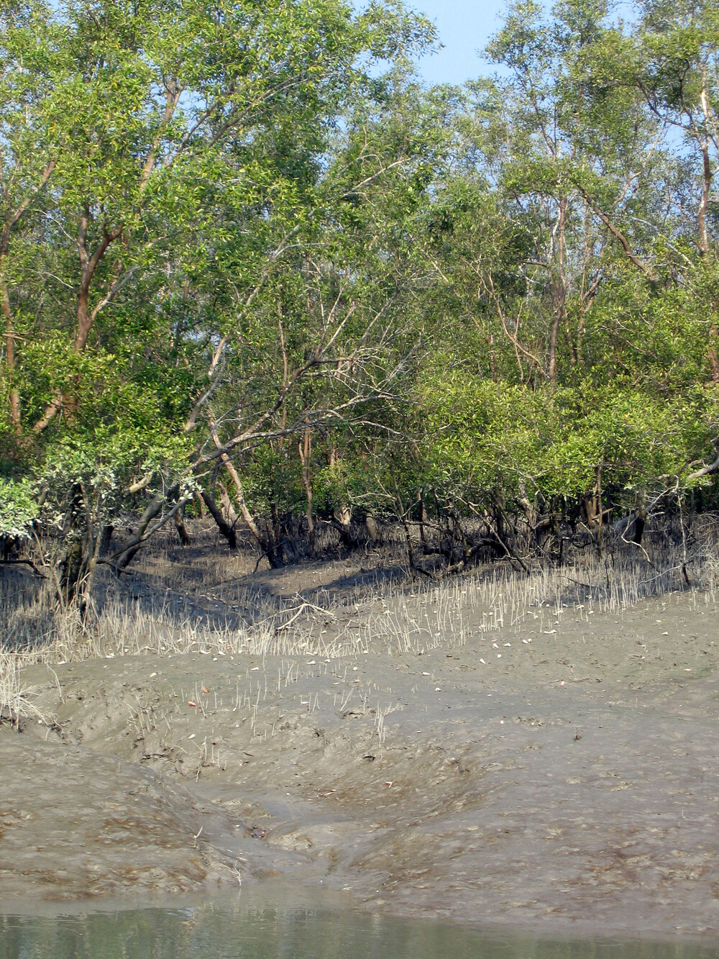
Sundarbans
The Sundarbans
The Sundarbans mangrove forest, one of the largest such forests in the world (140,000 ha), lies on the delta of the Ganges, Brahmaputra and Meghna rivers on the Bay of Bengal. It is adjacent to the border of India’s Sundarbans World Heritage site inscribed in 1987. The site is intersected by a complex network of tidal waterways, mudflats and small islands of salt-tolerant mangrove forests, and presents an excellent example of ongoing ecological processes. The area is known for its wide range of fauna, including 260 bird species, the Bengal tiger and other threatened species such as the estuarine crocodile and the Indian python.

Slide 5
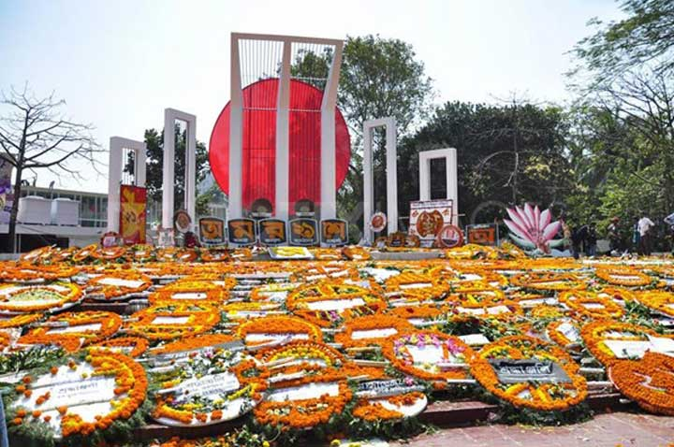
Shaheed Minar
Shaheed Minar or The Martyr Monument, stands near Dhaka Medical College. It symbolizes remembering the language martyrs of the 1952 language movement.
In 1952, due to the greater number of Bangla speakers, people protested to make ‘Bangla’ the state language over Urdu. In response, Pakistani police openly fired at the protesters to disassemble their movement. Agonizingly, a few students at Dhaka University and Dhaka Medical College died.
Bangladesh sculptor Hamidur Rahman along with Novera Ahmed, designed and built the modern Shaheed Minar.
Have you read about Dhaka Metro Rail, which has brought new hope to Dhaka city?
Eventually, February 21st, the day of the brutal incident, was declared International Mother Language Day. People remember these national heroes with flowers in front of Shaheed Minar on this day.

Slide 6
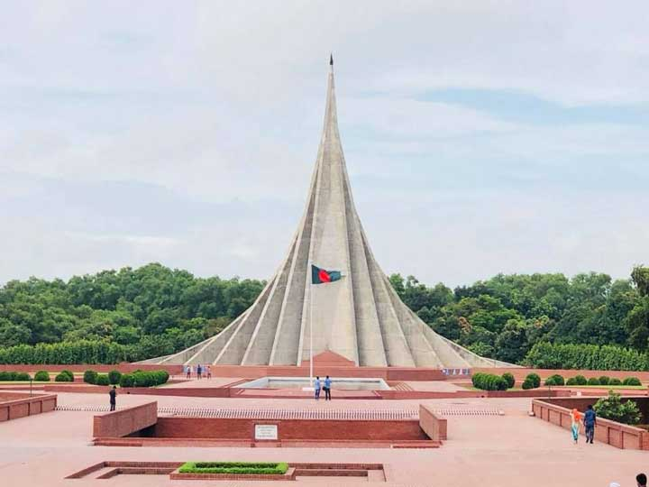
National Memorial
One of the most beautiful places in Savar, near Dhaka, is the National Memorial. It was founded to recall the memory of the 7 major War Heroes of the Liberation War in 1971.
Bangladeshi Structural Engineer and Architect Syed Mainul Hossain designed this remarkable memorial. The monument consists of 7 different segments that stand proudly together to represent the 7 War Heroes.
Staggeringly, the complex has an area of 84 acres. National Parade, Scouting Display, Liberation War songs and related programs are displayed here annually on the victory day, 16th December. Besides, it’s a regular visiting spot for general people all of the time.
For now, it’s all about the top historical places in Bangladesh. If you have any suggestions, please inform us in the comment section. We are ready to make Bangladesh discoverable from anywhere in the world. Travel Mate Bangladesh arranges regular tours of different historical sites in Bangladesh

Slide 7
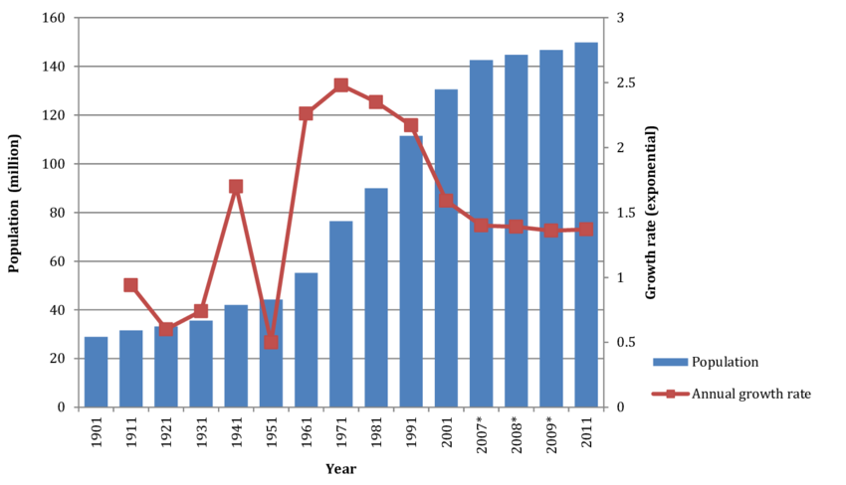
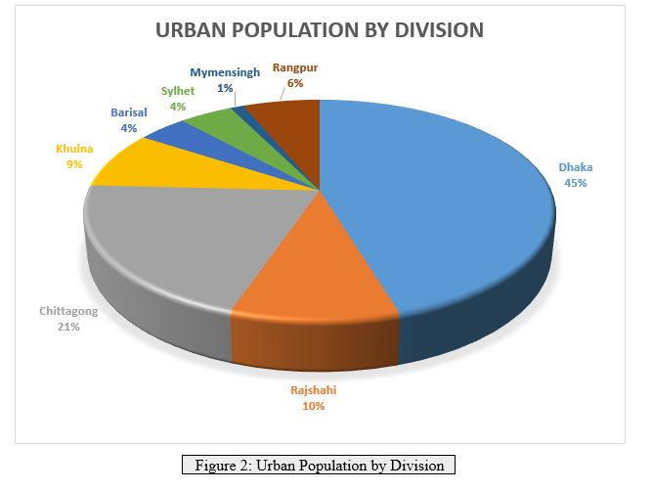
Population

Slide 8
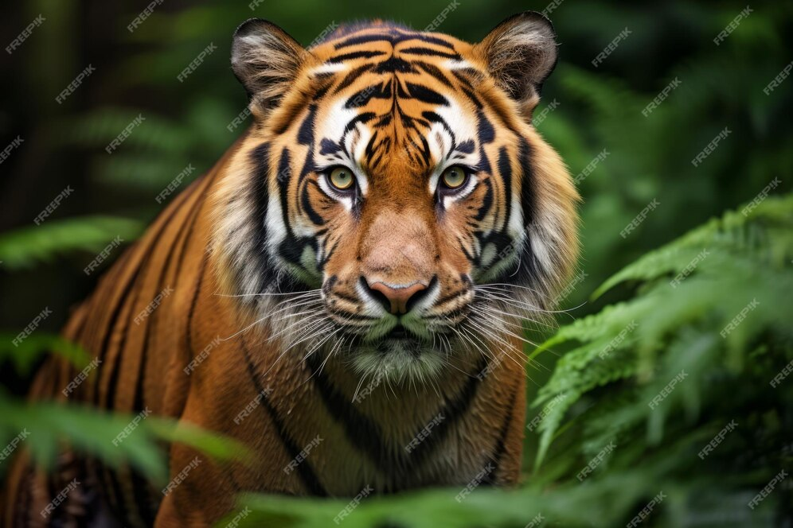
National Animal of Bangladesh
The Bengal tiger (Panthera tigris tigris) is the national animal of Bangladesh. Its population has been estimated to be at approximately 440 tigers in Bangladesh.^{[19][20]} Tigers in Bangladesh are now relegated to the forests of the Sundarbans and the Chittagong Hill Tracts.^{[19]} The tiger replaces the lion as king of the beasts in cultures of eastern Asia representing royalty, fearlessness and wrath.^{[21]} Members of the East Bengal Regiment of the Bangladesh Army are nicknameed 'Bengal Tigers'; the regiment's logo is a tiger face and the Bangladesh Cricket Board's logo features a Bengal tige

Slide 9
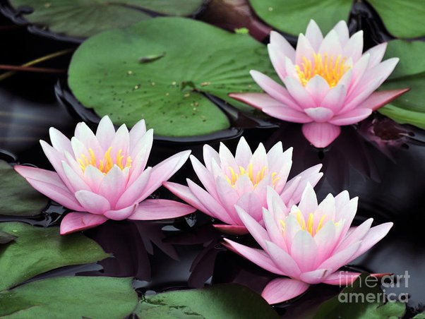
National Flower
The water lily (Nymphaea nouchali) is the national flower of Bangladesh. Nymphaea nouchali is considered a medicinal plant in Indian Ayurvedic medicine under the name ambal; it was mainly used to treat indigestion.^{[12]} Recent experiments have confirmed that it has medicinal qualities as an antihepatotoxic and antidiabetic.^{[13][14]} Like all waterlilies or lotuses, its tubers and rhizomes can be used as food items; they are eaten usually boiled or roasted. In the case of N. nouchali, its tender leaves and flower peduncles are also valued as food.^{[15]}

Slide 10
Thanks to all

